Slide 1

Deep Learning and IVF
First Rotation Project @ Hajirasouliha Lab

Slide 2
Overview
Objectives
Can we use imaging to explore non-invasive/unbiased methods to select best cells for IVF
Non-invasive: With Limited Information
Huge success if we can do better than invasive procedures
Still significant if we do as well or slightly worse
Unbiased: Removes subjectivity
Can we automate scoring procedures and manual checks
Can we improve on the existing scoring metric
Issues? – Quantization
Can we use imaging to gain insight into whether mosaic blastocysts, which are currently identified as Aneuploids, are Euploids?
Mosaicism

Slide 3
Potential Challenges to the Project
Non-invasiveness
Limited Access to Information
No genetic information
High SNR
Biological Information
Probabilistic Approaches
Potential Mislabeling of Datapoints
Due to Mosaicism, some cells labelled as Aneuploid might as well be Euploid

Slide 4

Contents
Data
Preprocessing
Model Choice
Performance

Slide 5
1. Data

Slide 6
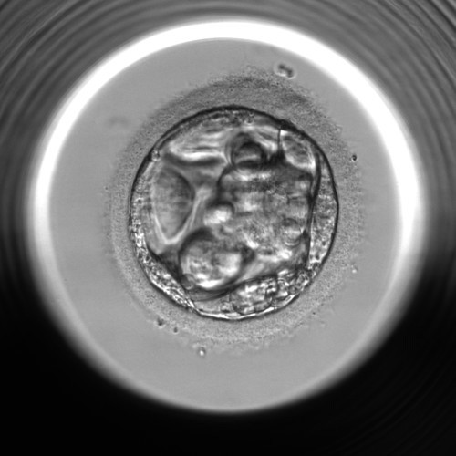
Data (size: ~10k)
Metadata
Patient Age
Morphokinetics
Quality Scores
Veeck & Zaninovic scoring
Blastocyst Scores
Inner Cell Mass / Trophectoderm Score
Expansion Scores
Different Metrics
Image (500x500 pixels)
Blastocyst

Slide 7
Data Exploration (Metadata)
Class Distribution
Biggest Chunk: EUP, CxA
Most Important Metadata Feature is Age of the patient
Both by T-test (****: p-value < 10⁻²¹) and by XGBoost feature importance
Can Achieve 50% accuracy based on XGBoost w/ Metadata Only

Slide 8
Setting Baseline Models with Patient Age
Thresholds at Age 38.38 and 38.77 each green and red respectively
Decision Rule
EUP: AGE <= 38.38
ANU: 38.38 < AGE <= 38.77
CxA: 38.77 < AGE
Would Yield ~50% Accuracy with Age Information Only

Slide 9
Denoise Metric for Selecting best Blastocysts
Convert Non-numeric scoring system into numeric ones
Take the mean of all the scores / PCA on these columns
Unbiased Scoring System
PC1 Feature Vector Captures ~90% Variance

Slide 10
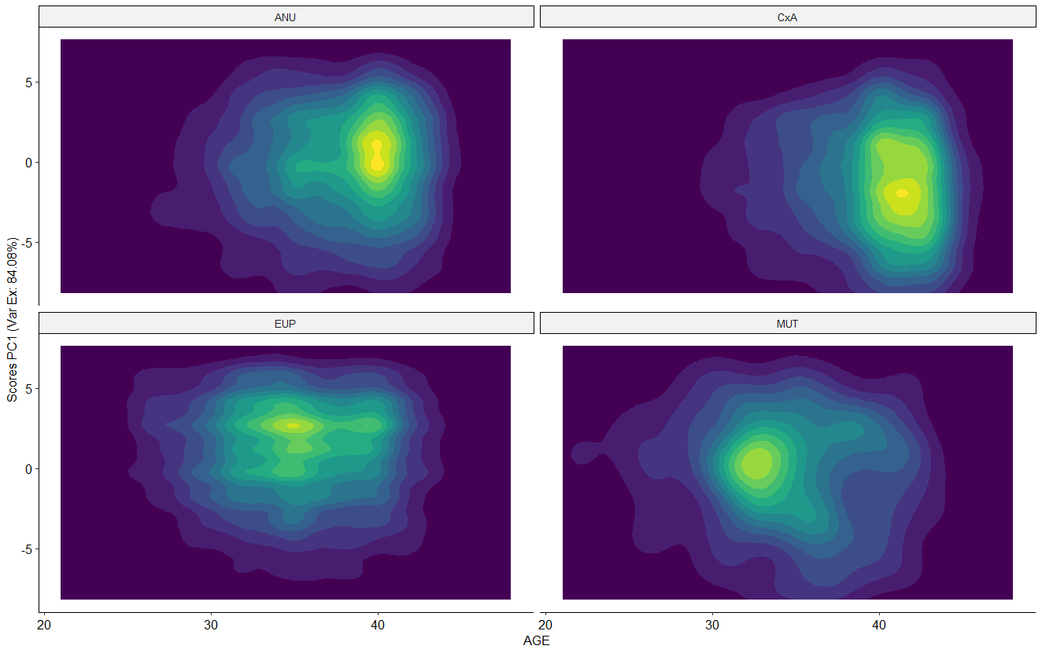
Unbiased Metric for Selecting best Blastocysts
ANU
EUP
CxA

Slide 11
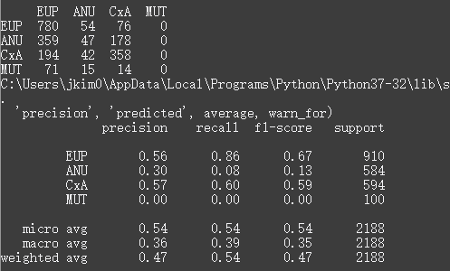
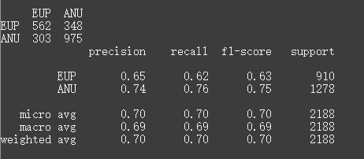
XGBoost Classification Results Using Metadata Only
Binary Classification (70.25%)
4-ary Classification Results (54.16%)

Slide 12
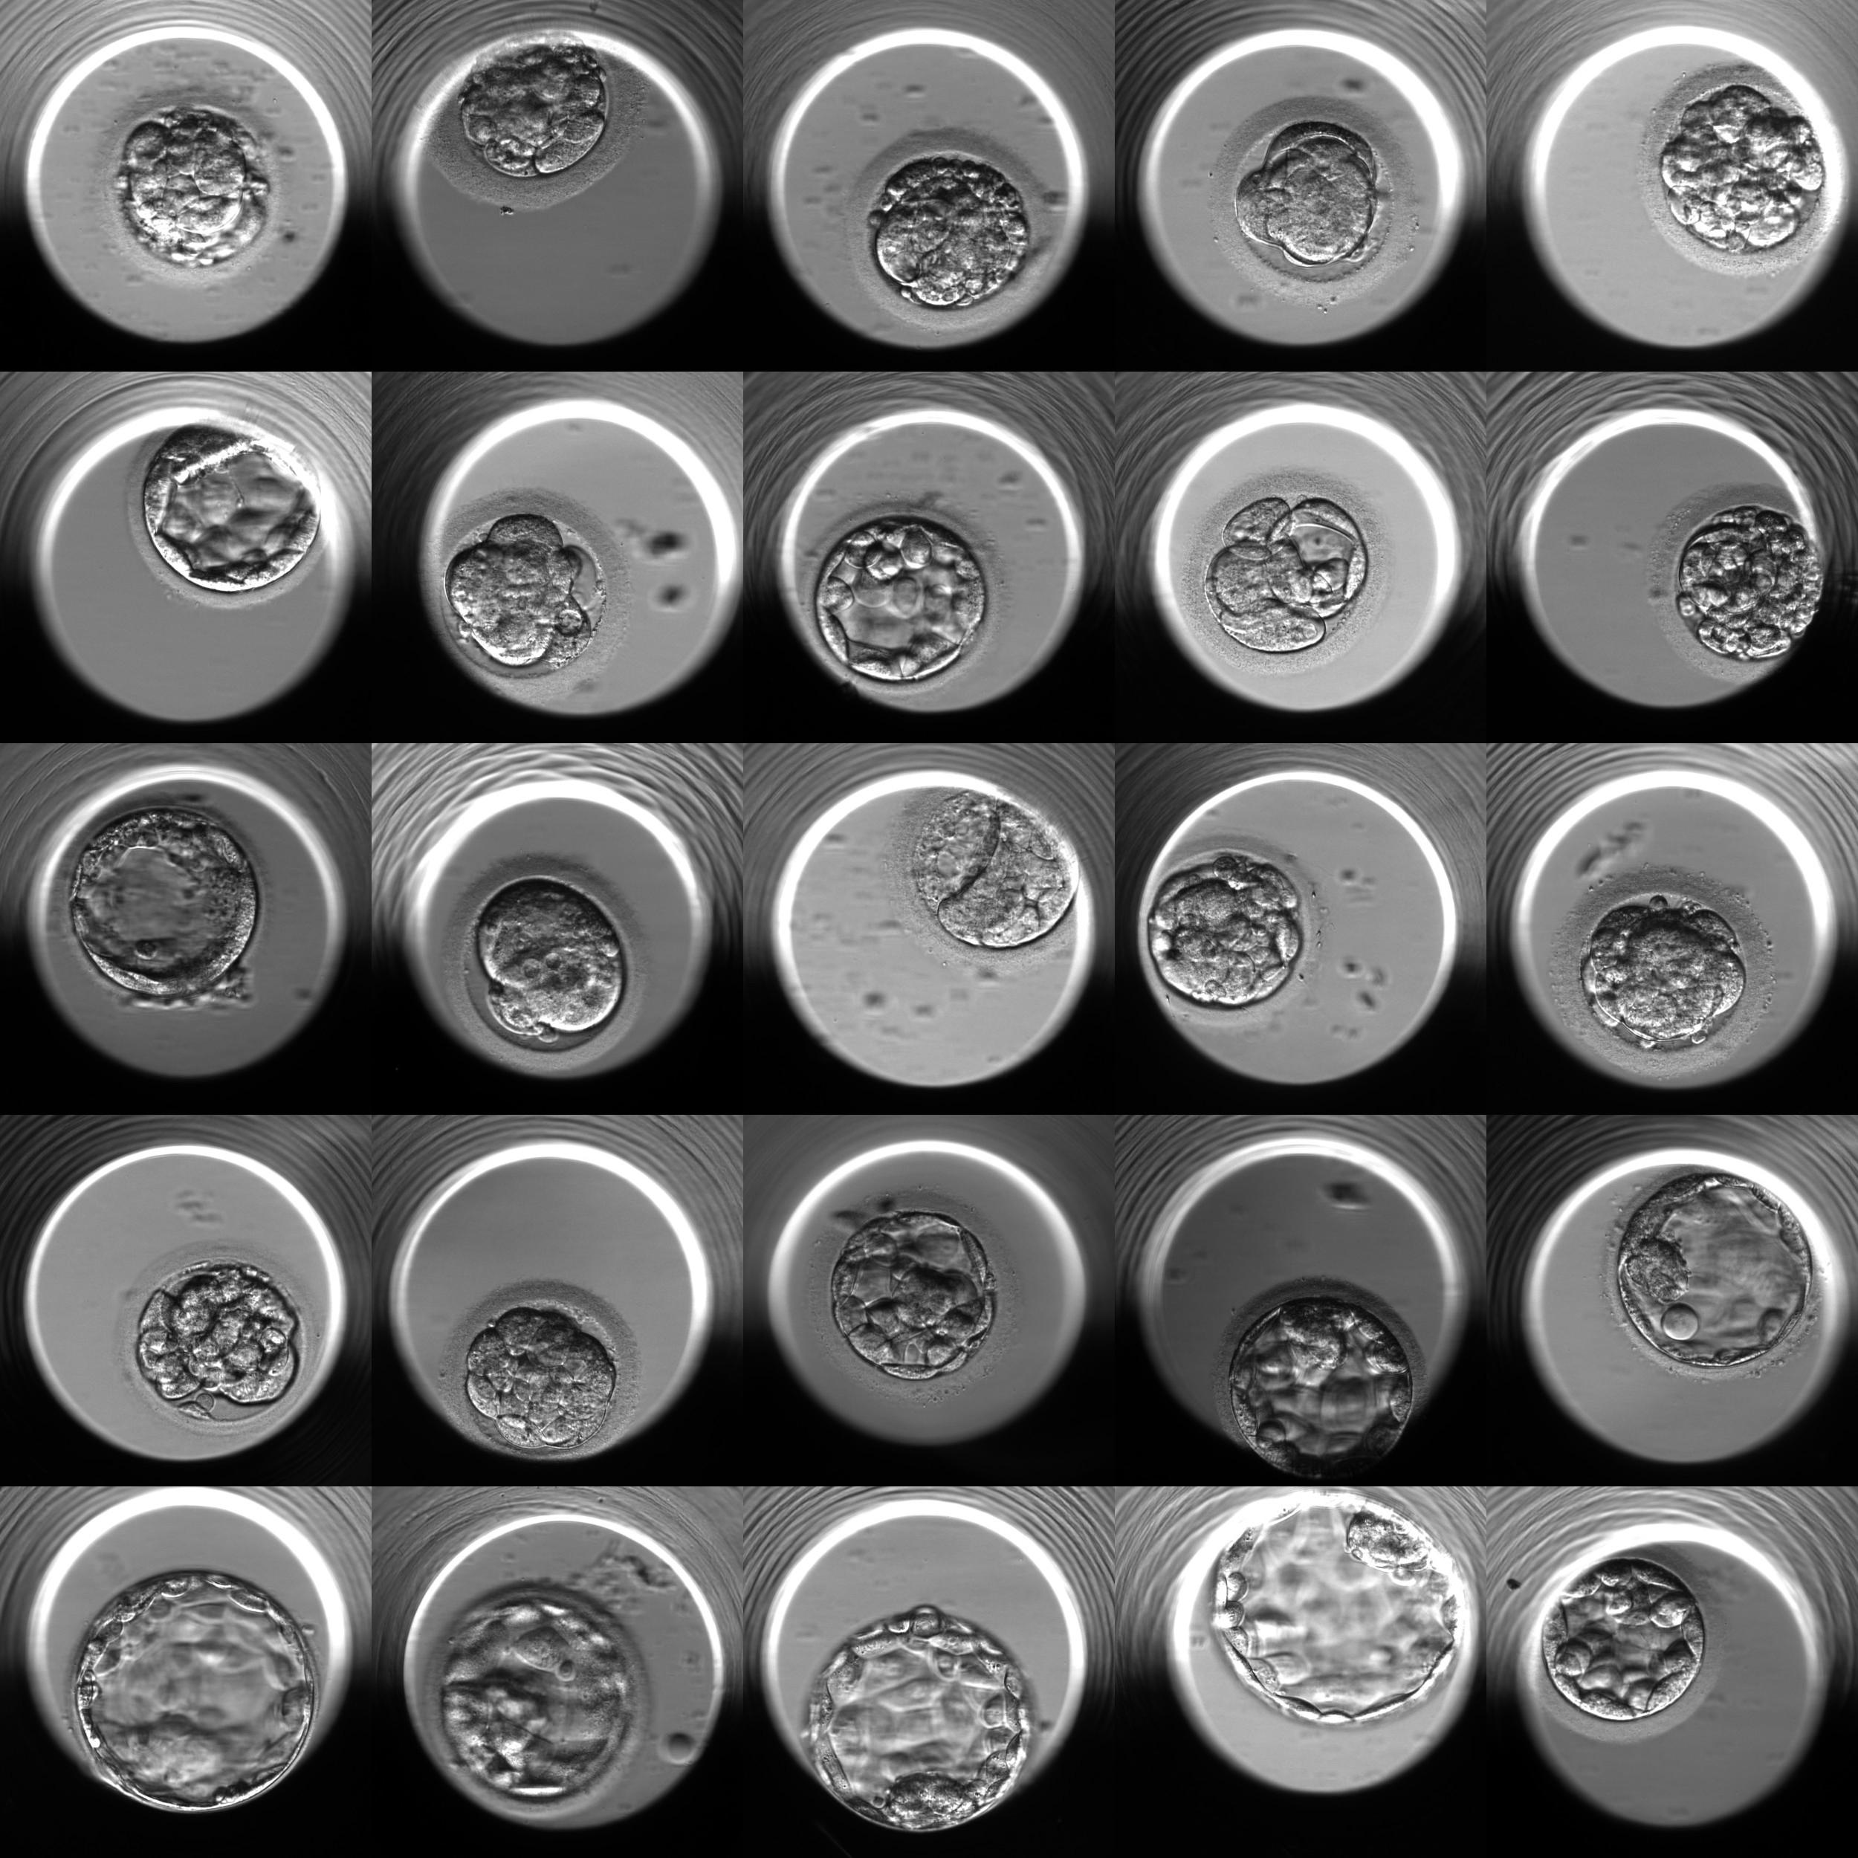
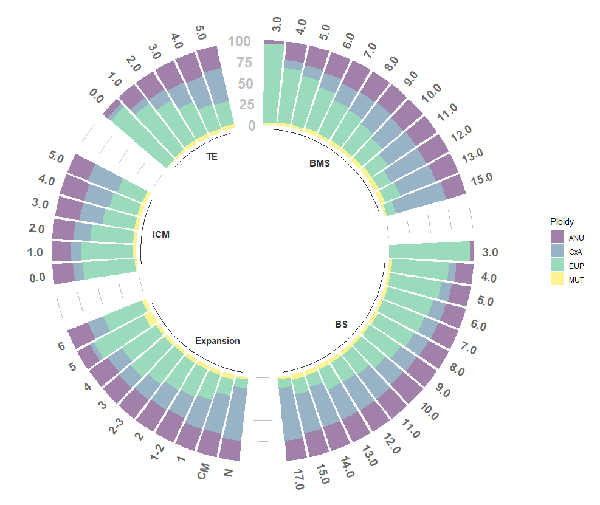
BMS
1512
9
6
3

Slide 13
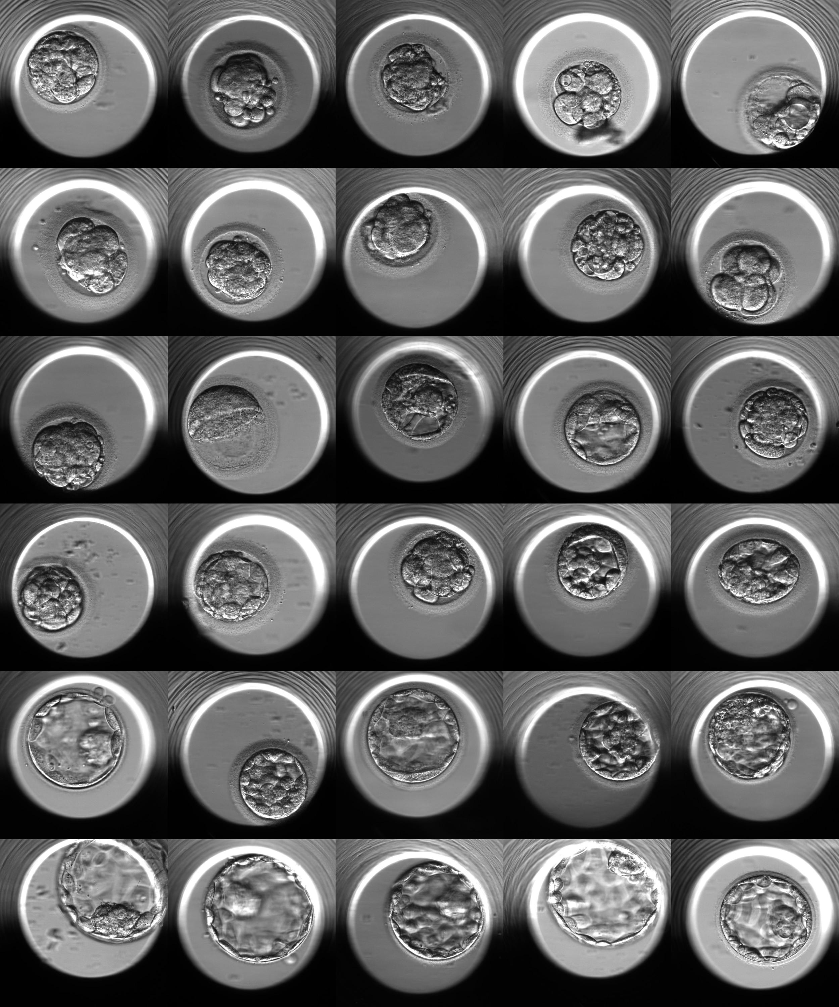
BS
17
15
12
9
6
3

Slide 14
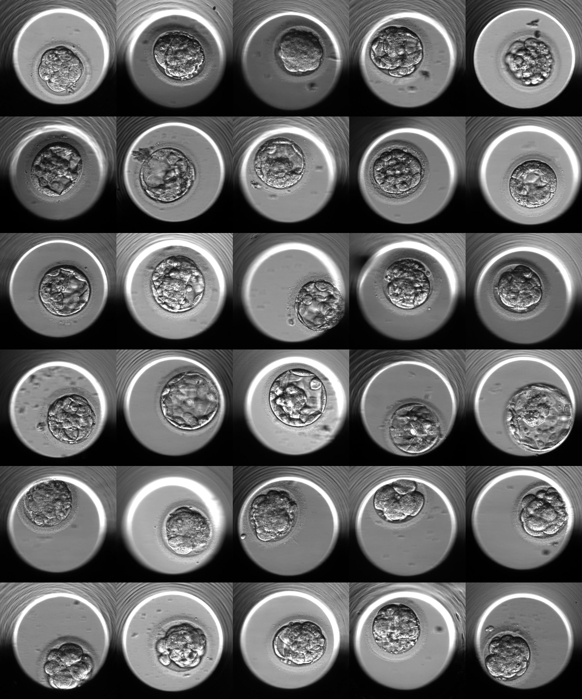
Expansion
CM
N
2
3
4
5

Slide 15
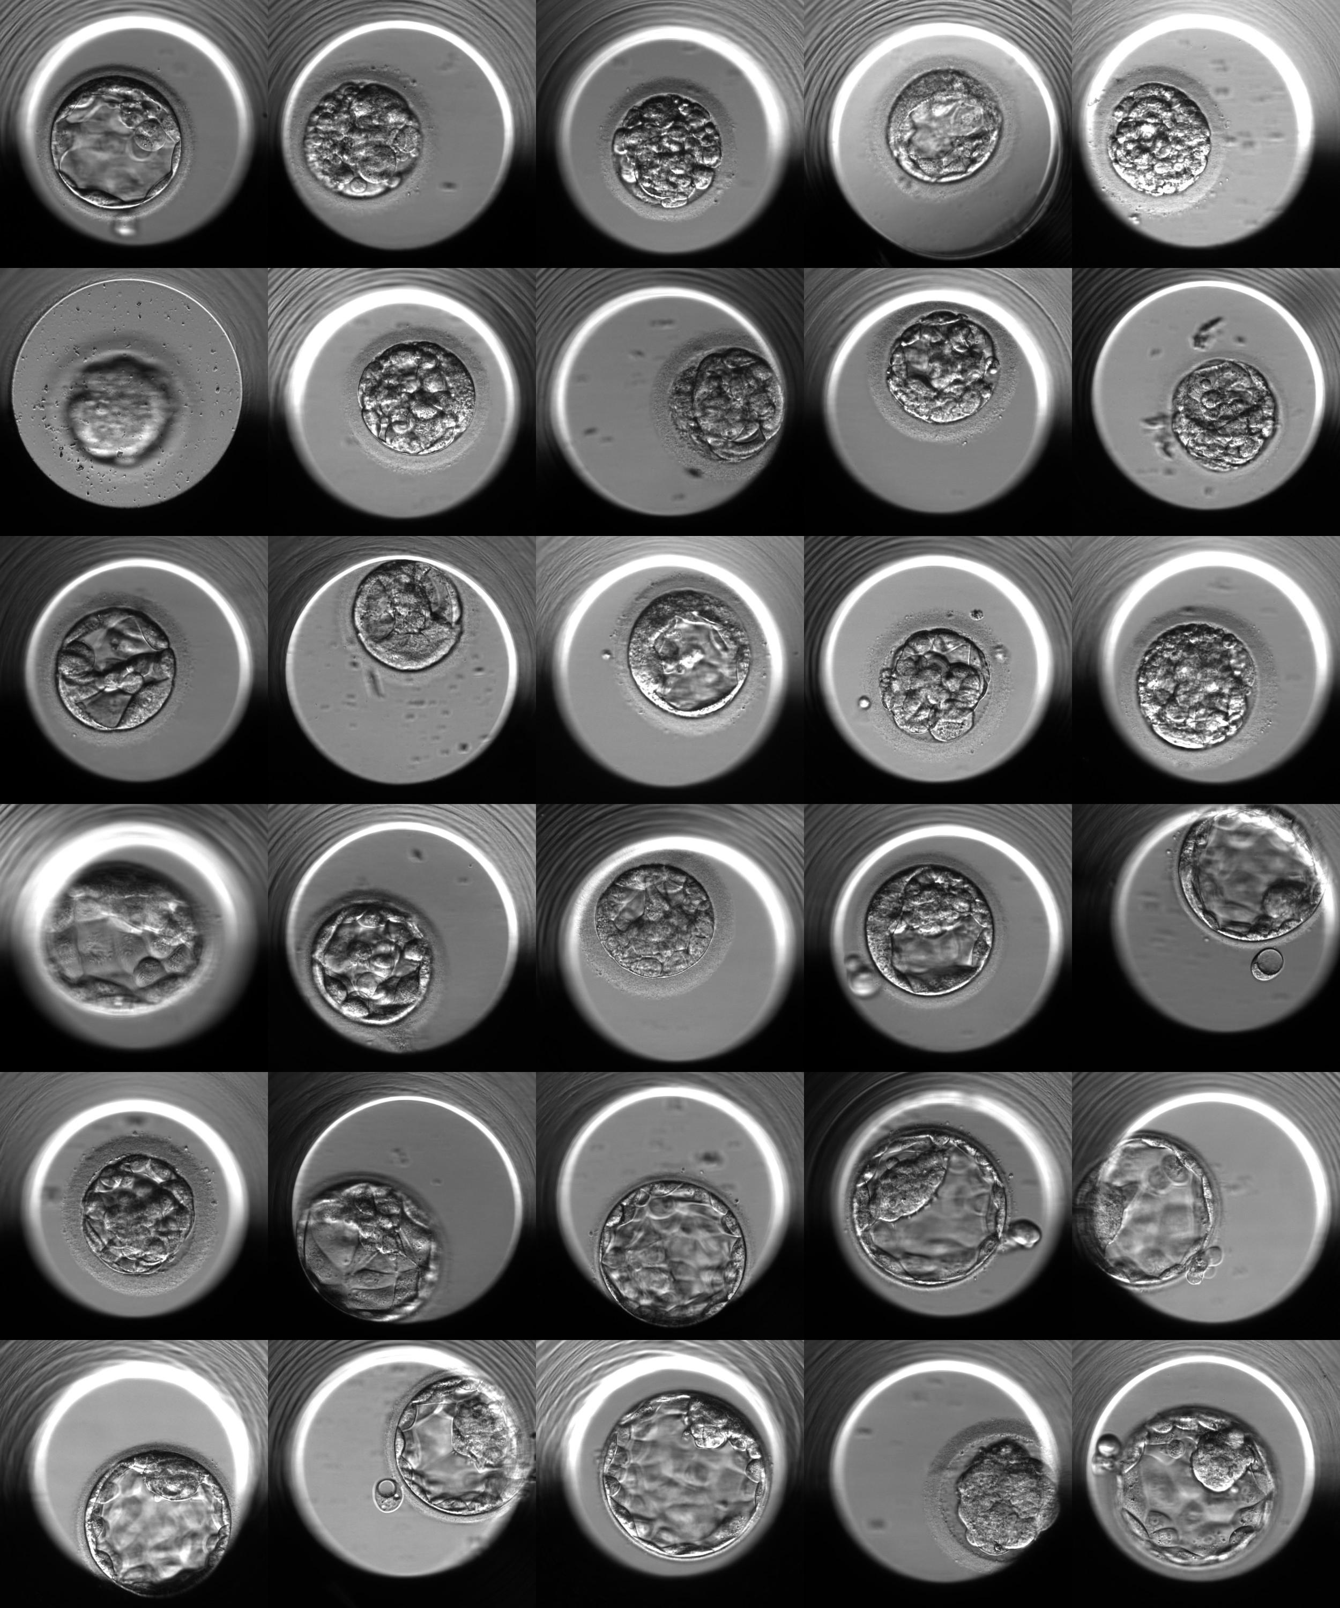
ICM (Inner Cell Mass)
5 (C)
4 (B-/C)
3 (B-)
2 (B)
1 (A-)
0 (A)

Slide 16
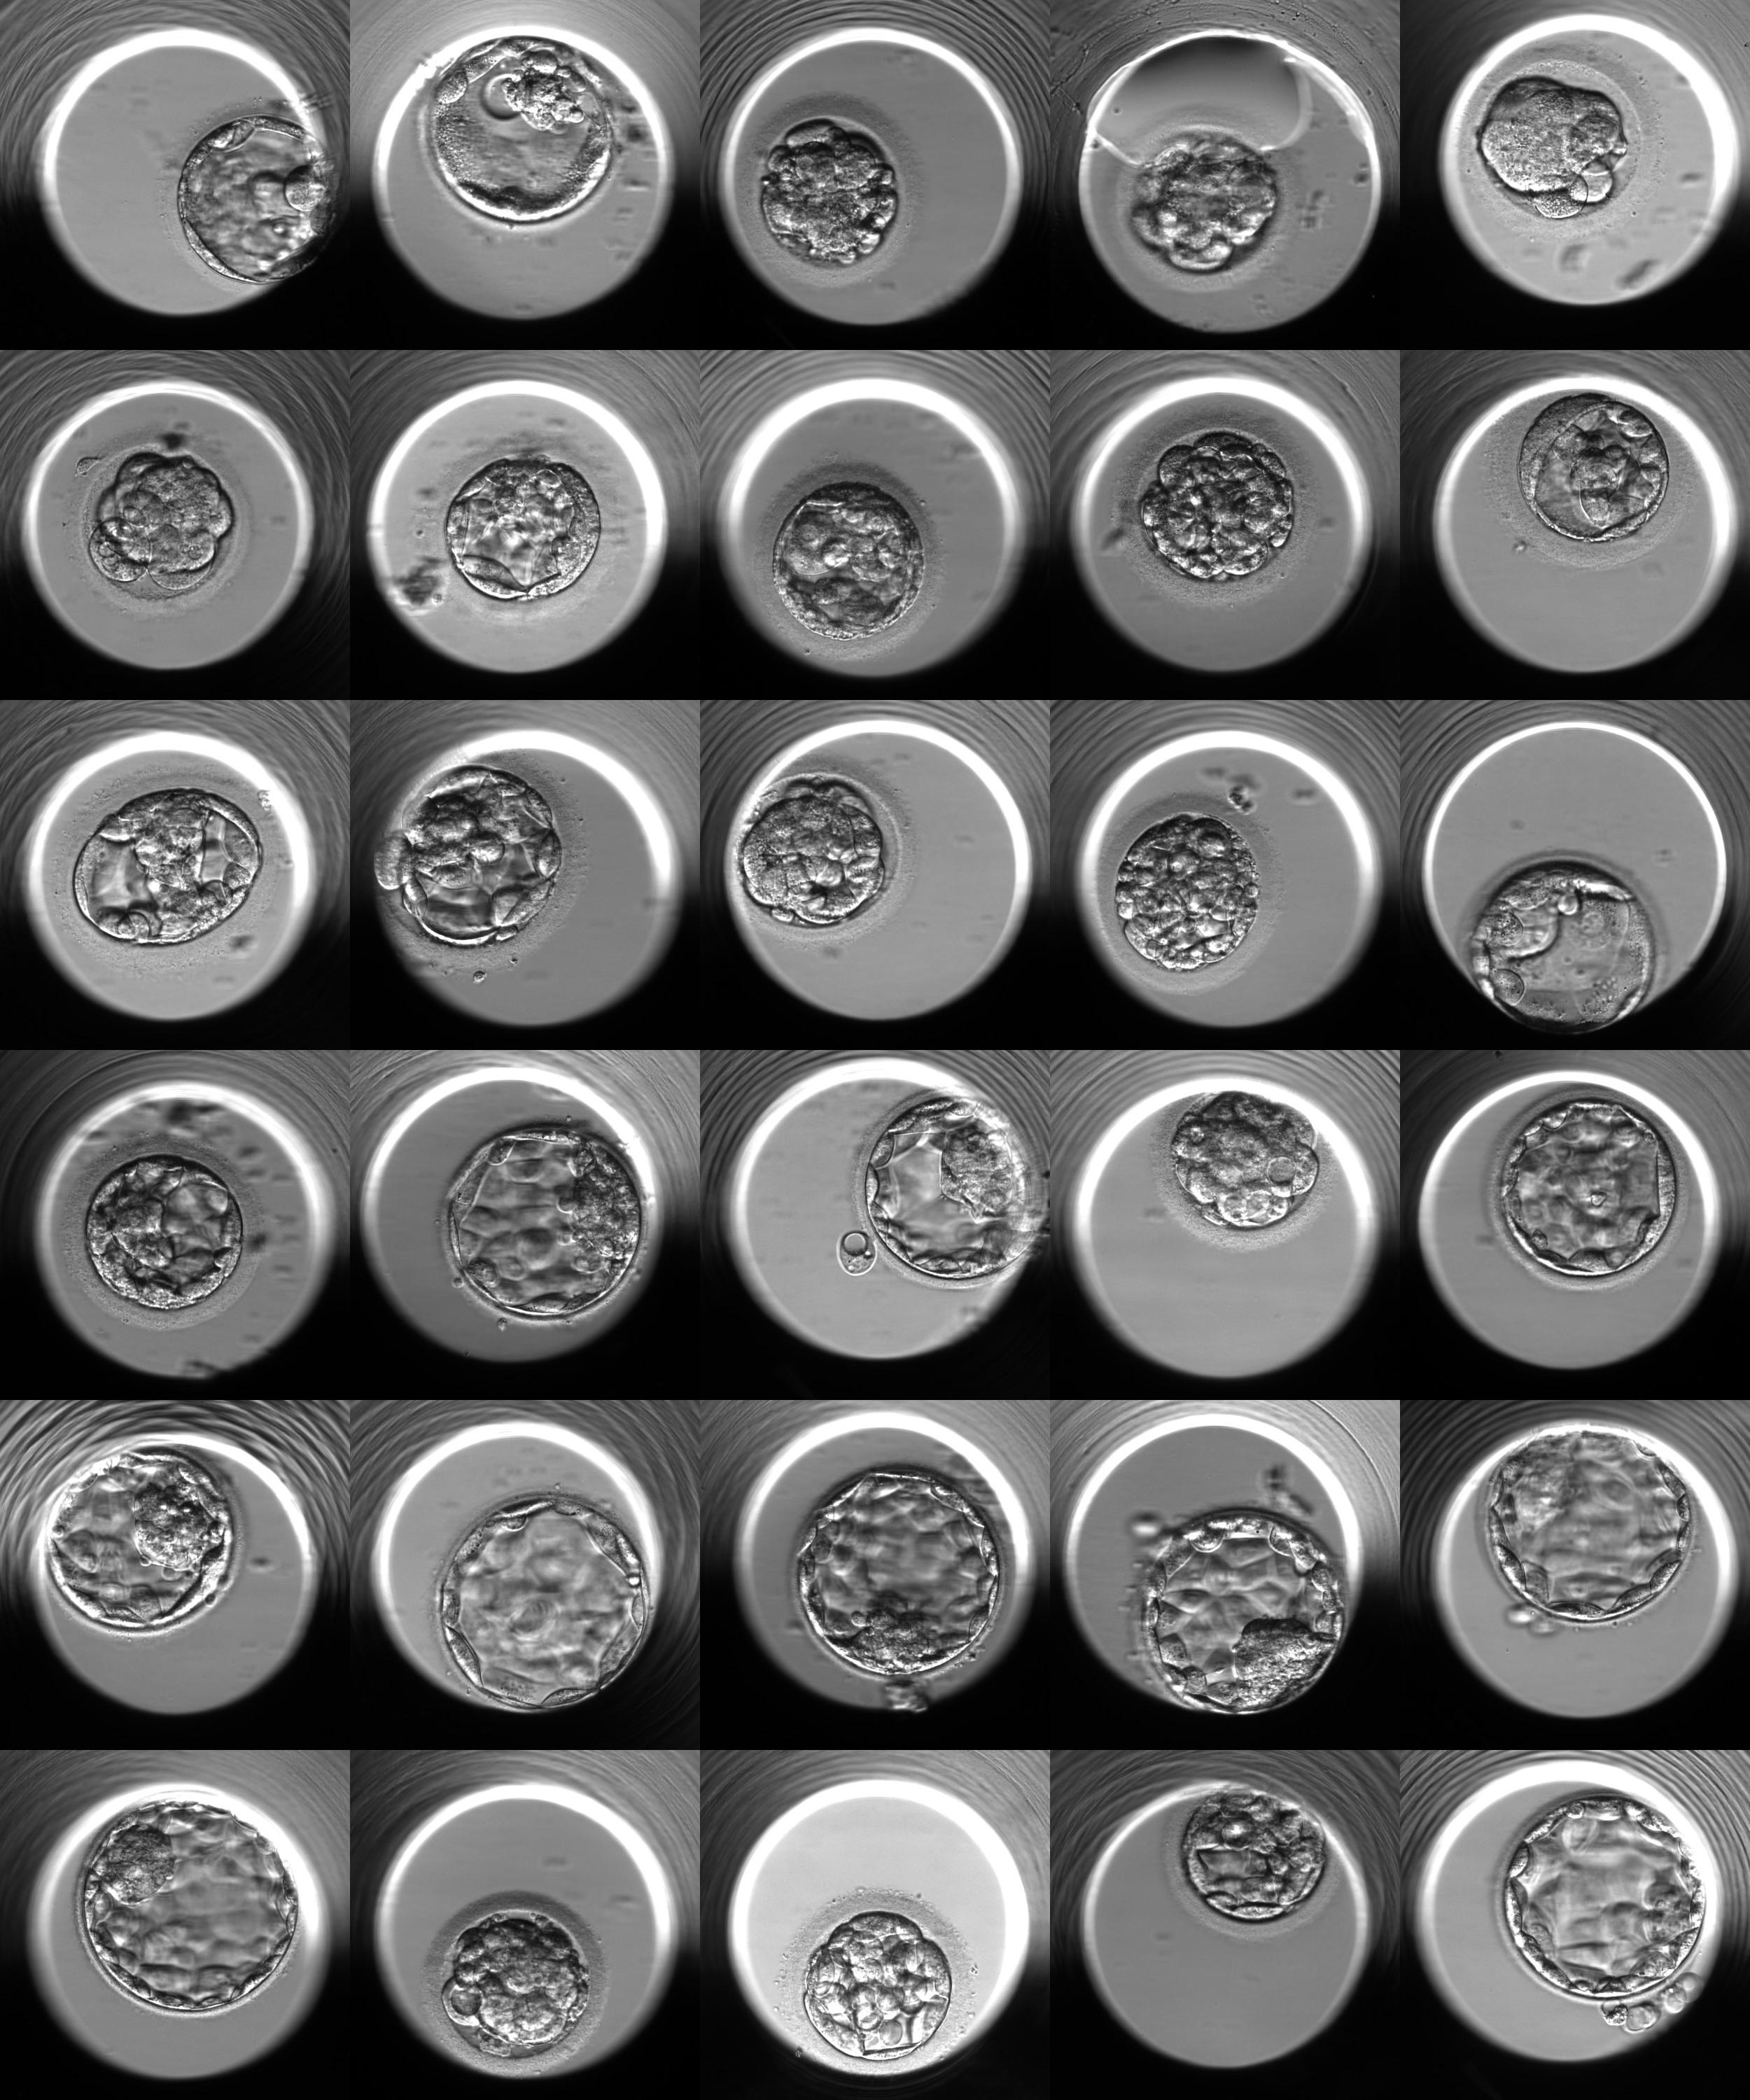
TE (Trophectoderm)
5 (C)
4 (B-/C)
3 (B-)
2 (B)
1 (A-)
0 (A)

Slide 17
Data (Image)
N =10k for 500x500 pixel image is on the very small data for Deep Learning
Overfitting is an Issue
Preprocessing Matters
Data Augmentation
TBC…

Slide 18
2. Preprocessing

Slide 19
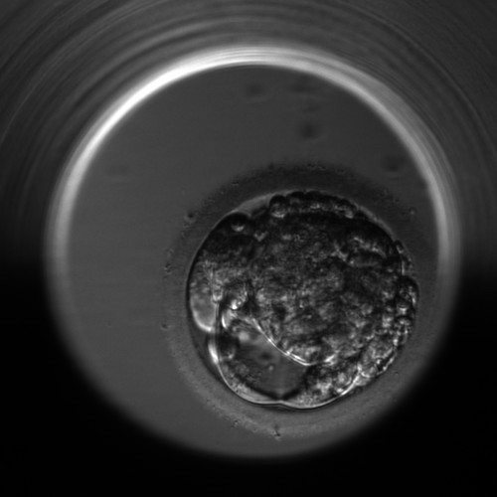
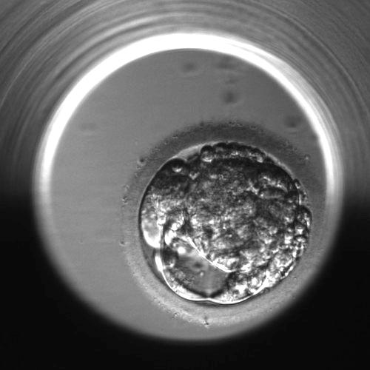
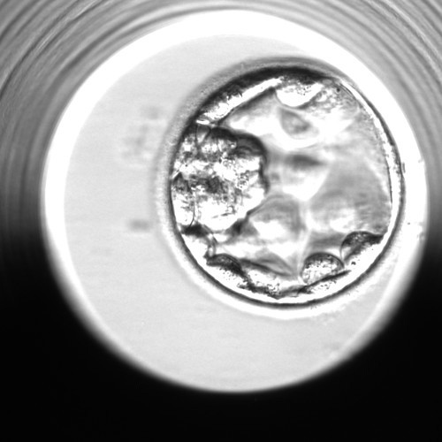
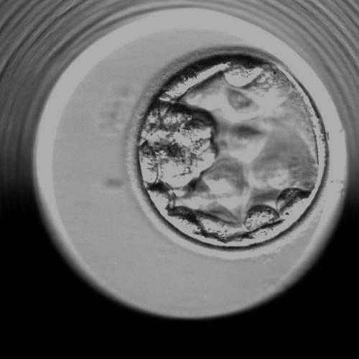
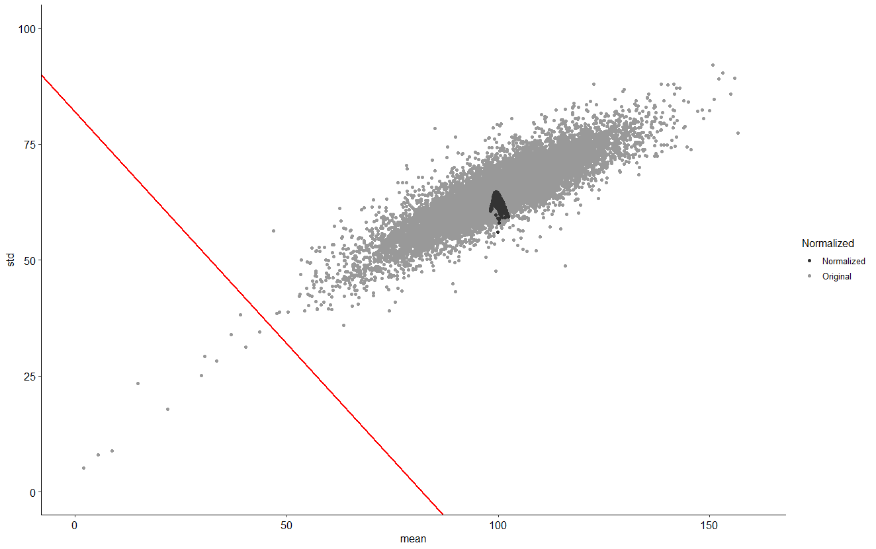
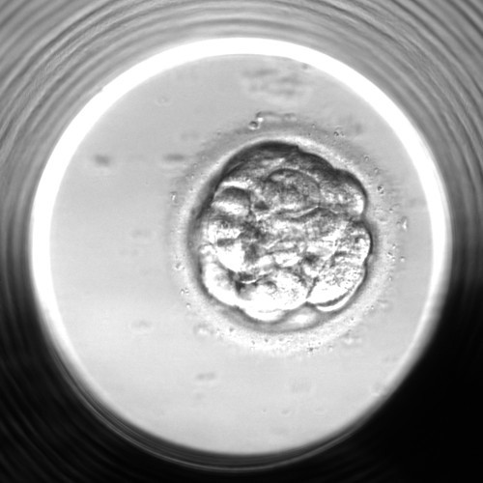
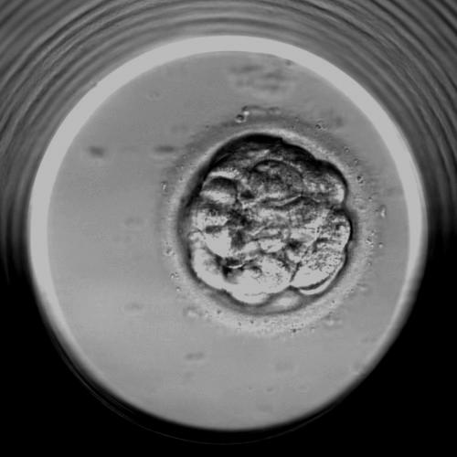
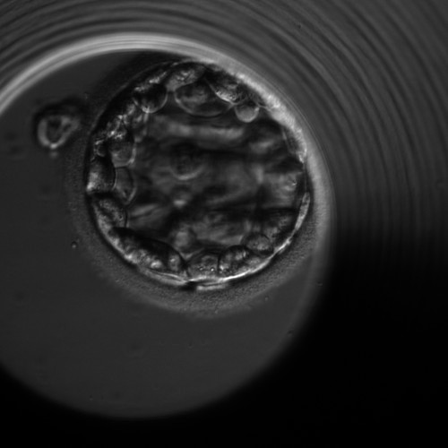

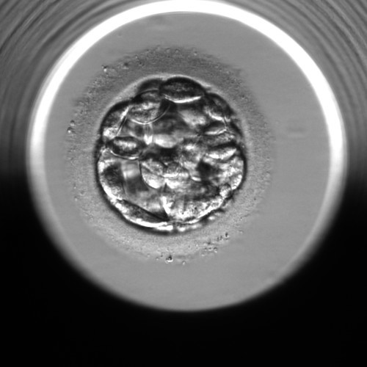
Image Quality Check / Normalization

Slide 20
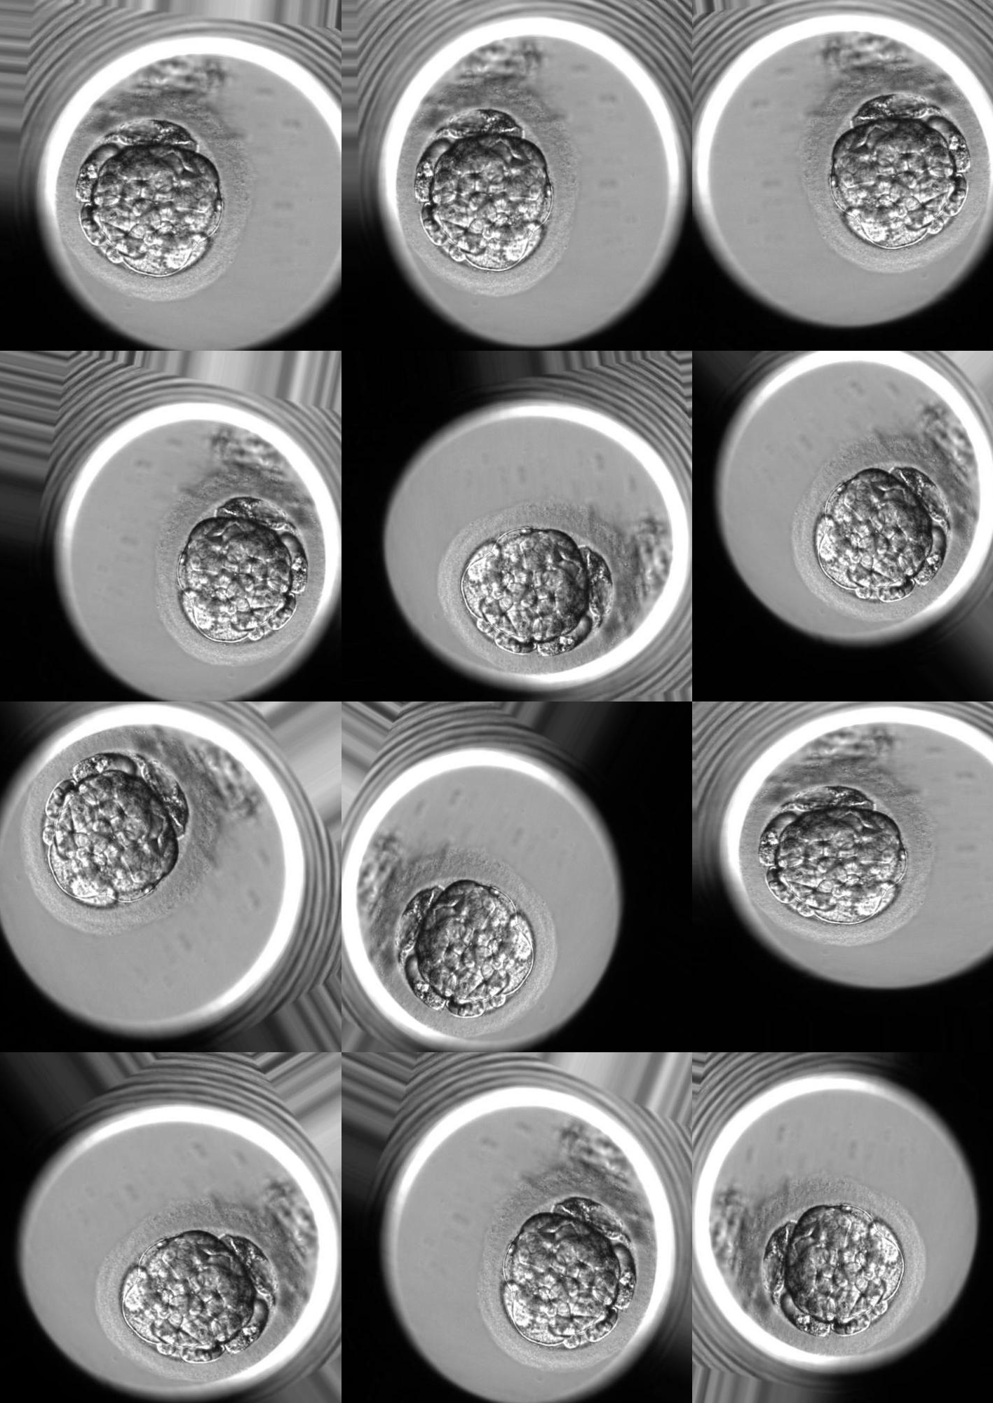
Image Augmentation
Ways to increase number of samples for almost free
Blastocyte images are rotationally and translationally invariant
Possible Operations
Rotation
Translation
Brightness (Not Implemented Yet)
Contrast (Not Implemented Yet)

Slide 21
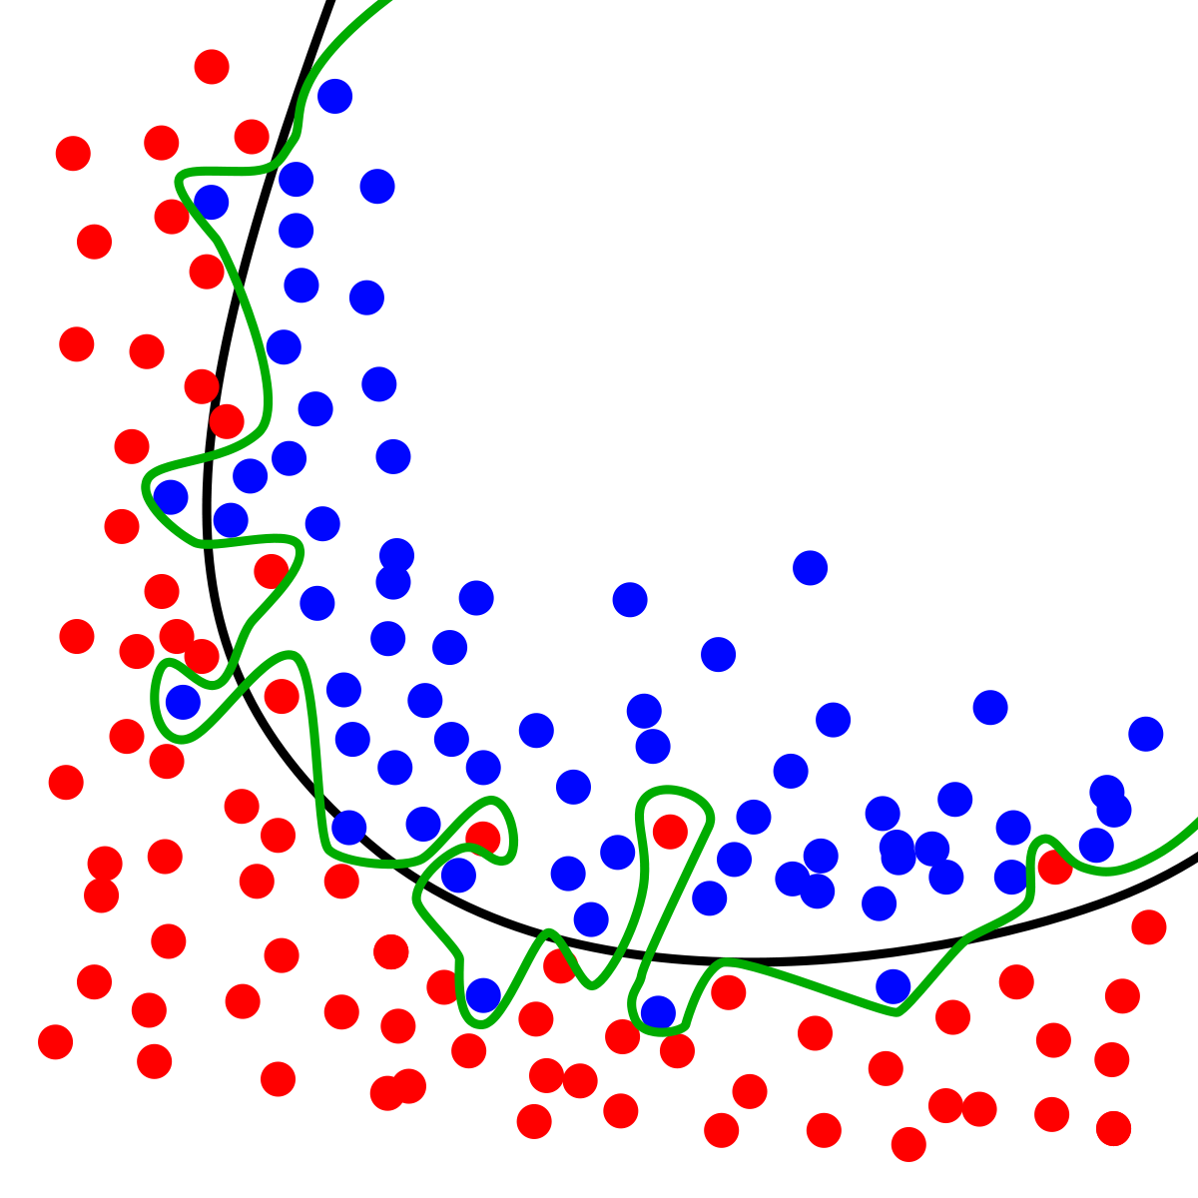
Noise Reduction Through Image Manipulation
Overfitting – Training Accuracy: 100%, Validation Accuracy: 35%
Feature Extraction
Customized Loss Function – Higher Specificity: In addition to asking what the ploidy status, also try to learn how good the Expansion, Trophectoderm teeth definition, and ICM formulation is
Optimize for both Classification of Ploidy Status and Regression of Scores
Perform Regression of Scores and finetune for Classification of Ploidy Status at the end
Attention Layer
ICM, Trophectoderm Extraction
Hough Circle Detection
Zoom into Blastocyst Center / Reduce Number of Pixels
Intensity Based Color Filtering

Slide 22
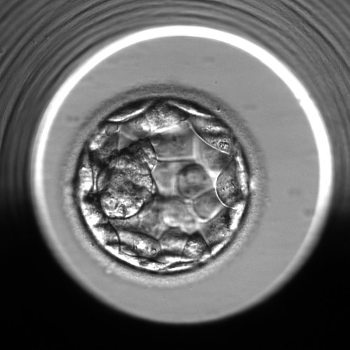
Attention Layer – Adaptive Masking
TBD
Original Image
Trophectoderm Masking
ICM Masking

Slide 23
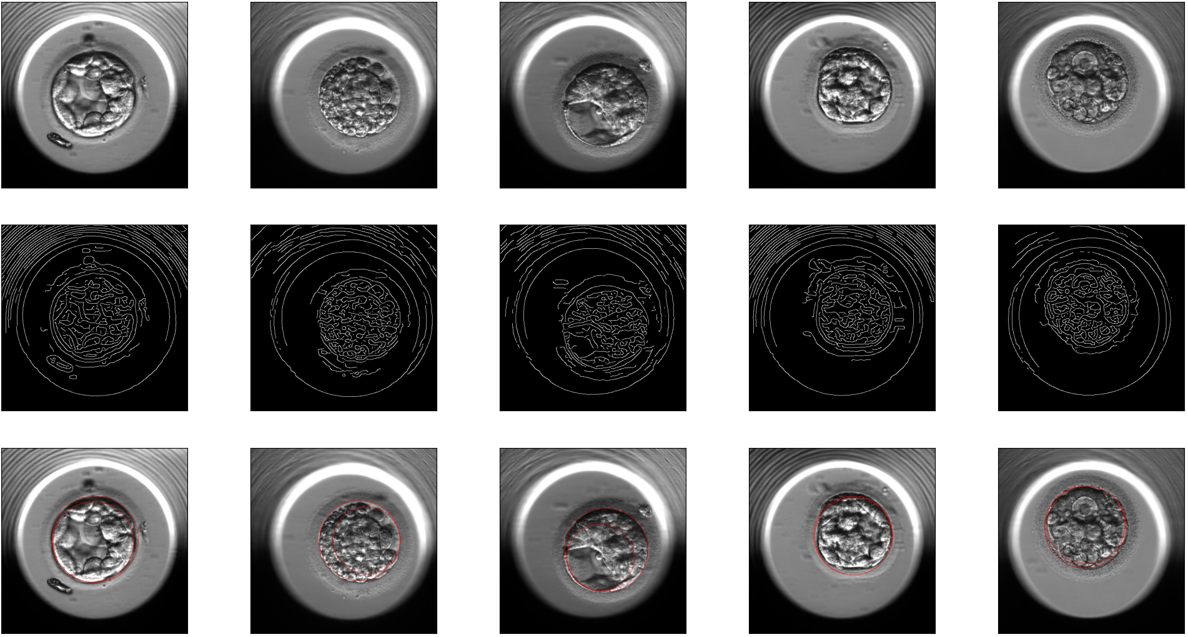
Hough Circle Detection
TBD
Original Image
Canny Filter
Circle Detected

Slide 24
3. Model Choice

Slide 25
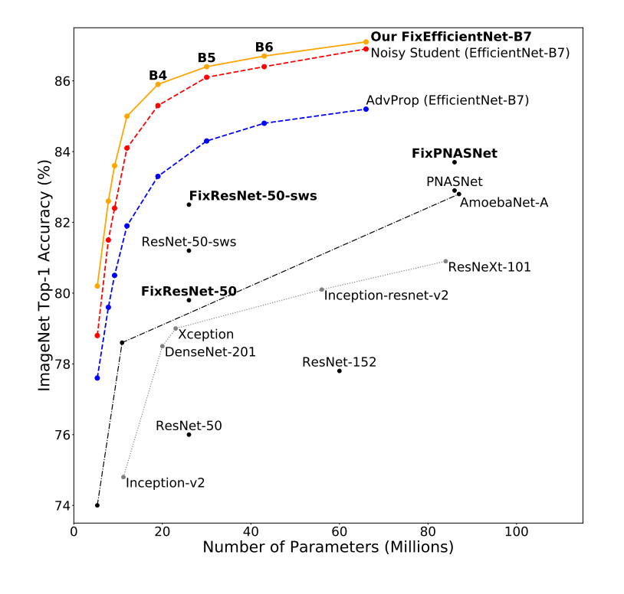
Model Choice
ResNet 34
EfficientNetB0
EfficientNetB4

Slide 26
Customized Loss Function
Learn how to predict …
Ploidy Status
Trophectoderm Scores
ICM Scores
Expansion Scores
Etc…
All at the same time
Make sure we learn all the features
Loss = c₁ *mse(TE) + c₂ *mse(ICM) + c₃*mse(Expansion) + cross-entropy(ploidy status)

Slide 27
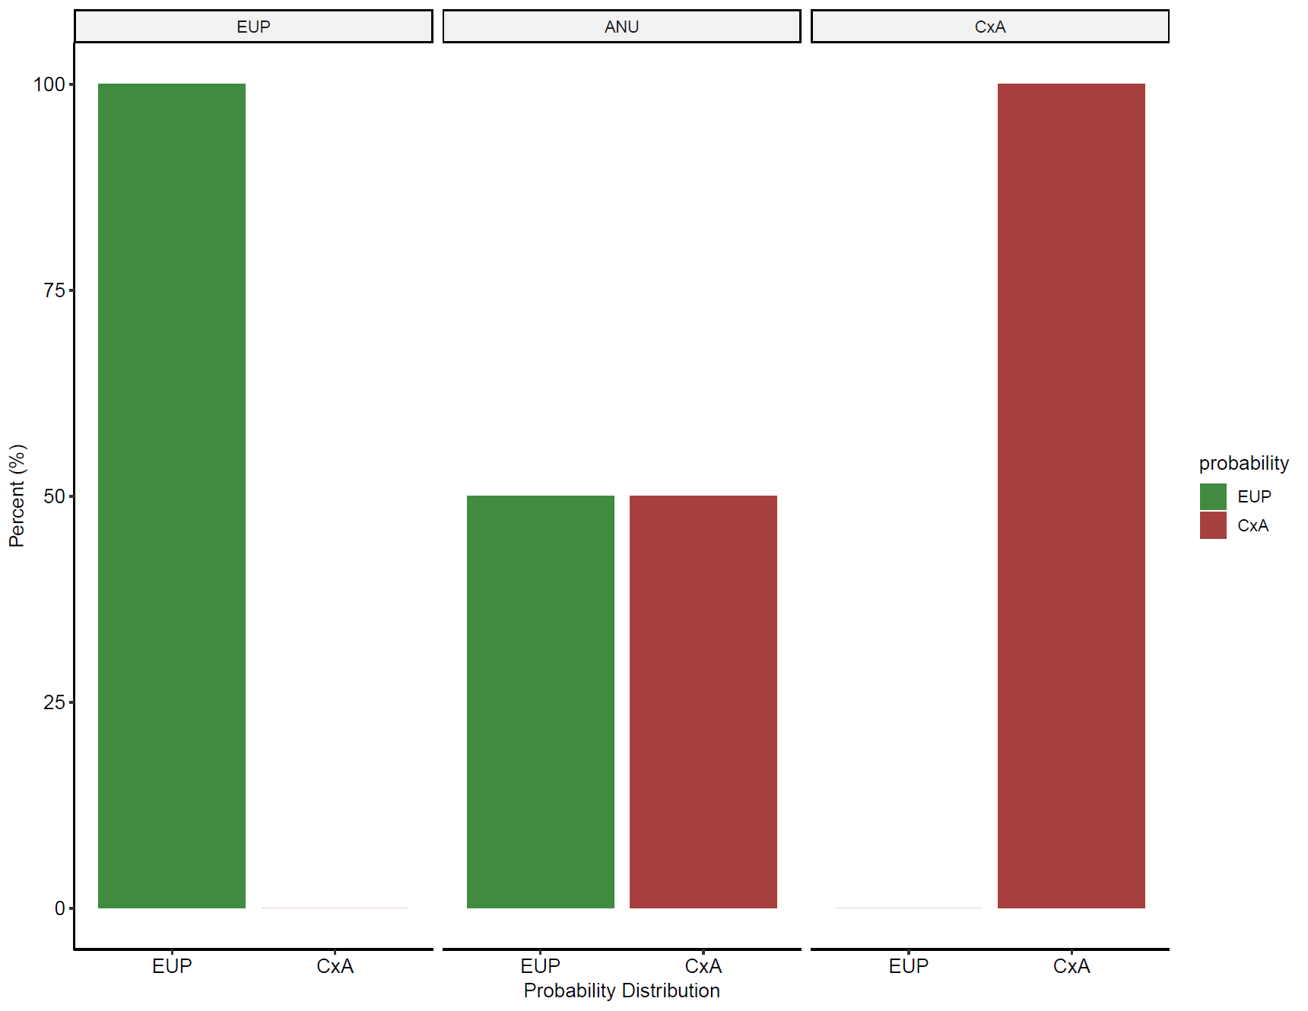
Addressing Ploidy Status of Blastocysts
TBD
Soft Labeling for Aneuploids
Mosaicism
We are not sure what their true label is!

Slide 28
4. Performance

